Slide 1
Content
SAP Overview
ABAP Dictionary/ Data Dictionary
ABAP Basics
Reports
Module Pool Programming
Layout Sets
Data Conversions
Modification and Enhancements
Connectivity
Notes:
First Slide

Slide 2
Content
Overview of Module Pool Programming
Screen Painter & Screen Flow Logic
Simple UI Elements
Input Validation
Navigation
Static Navigation
Dynamic Navigation
Complex UI Elements
Tables
Tab strip
Sub screen
Notes:
First Slide

Slide 3
Module pool Programming
Overview
Module pool program is a sequence of screens and logic behind these screen . It contains
two main programs
Dynpro (Screen + Flow Logic)
ABAP/4 Program
We will design screens using Screen Painter. Flow logic contains following set of events.
PBO – Process Before Event
PAI – Process After Input
POV – Process On Value Request
POH – Process on Help Request
Business logic written ABAP/4 program in processing blocks so called MODULEs. These
Modules will be called by screen flow logic
Workbench Transactions:
SE51 - Screen Painter
SE41 – GUI Status
SE38 – ABAP Program
SE93 – Transaction
OR
SE80 – Object Navigator
Example: ME21N, ME21, VA01 etc..
Module Pool Programming
Overview
Screen Painter
Simple UI Elements
Input Validation
Navigation
Complex UI Elements
Notes:
First Slide

Slide 4
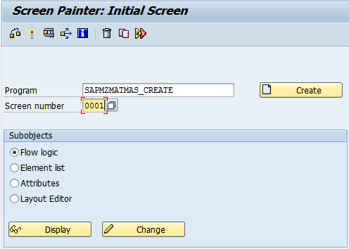
Module pool Programming
Screen Painter
Screen Painter: SE51
Flow Logic:
This is the place where we call ABAP Logic.
ABAP logic will be written in processing Blocks so called MODULES
Element List:
Properties of all of UI elements which are added in screen
Attributes:
Screen Attributes includes Description, Type of screen, Next screen To be displayed etc.
Layout Editor:
It is the place where we Actually place the UI elements. It is a Container of various UI elements. We Can link UI elements with ABAP/4 Data objects by providing same name to it
Module Pool Programming
Module Pool Programming
Overview
Overview
Selection Screen Design
Screen Painter
Program Name
Selection Screen Events
Simple UI Elements
Classical Reports
Input Validation
Screen Number
Interactive Reports
Navigation
ALV Reports
Complex UI Elements
Sub objects
Notes:
First Slide

Slide 5
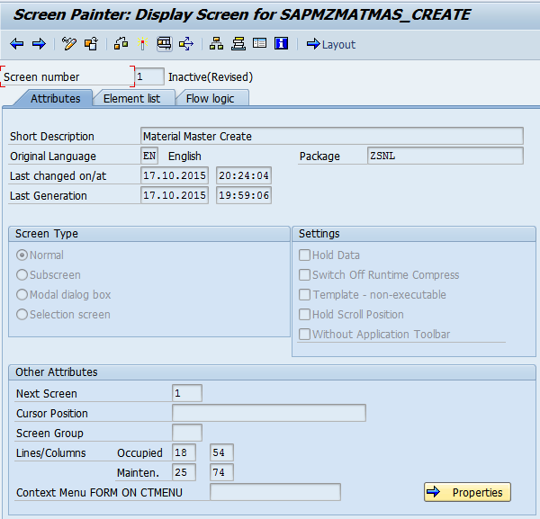
Module pool Programming
Screen Painter
Screen Type: It specifies the screen type
Normal:
General screen type
Sub screen:
To display screen in another Screen with help of sub screen area
Modal Dialog Box: to display screen as
Pop up dialog
Selection Screen:
To display selection Screen on module pool
Next Screen:
We have to specify screen number to
Navigate from one screen to other screen When processing completed in previous screen
Module Pool Programming
Overview
Screen Painter
Simple UI Elements
Input Validation
Screen Type
Navigation
Complex UI Elements
Next Screen to be displayed
Notes:
First Slide

Slide 6
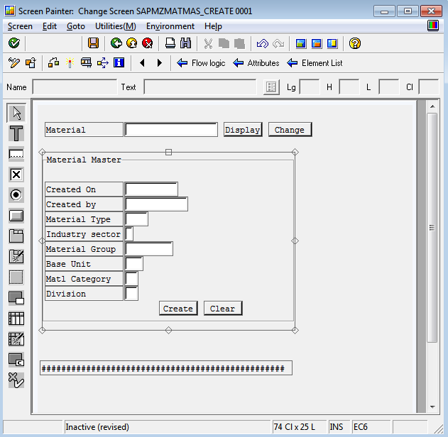
Module pool Programming
Screen Painter
Layout Editor: Screen Container
Module Pool Programming
We can drag and drop UI elements
From the left side window onto the
Screen UI container
Each UI element identified by the name. we will provide same name as
ABAP/4 Name
Function Keys Used:
F7- Element list window
F6- Dictionary/Program fields window
F2 – Attributes window
Overview
Screen Painter
Simple UI Elements
Input Validation
Navigation
Complex UI Elements
UI elements
Screen UI container
Notes:
First Slide

Slide 7
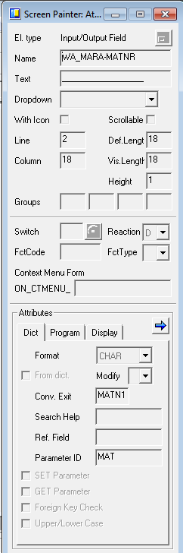
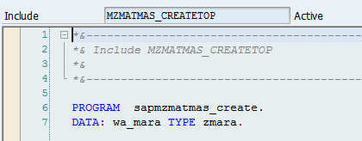
Module pool Programming
Screen Painter
Layout Editor: Field Properties
Input field name
Module Pool Programming
Overview
Screen Painter
Position on screen
Simple UI Elements
Input Validation
Declared work area in ABAP/4 Program
Navigation
Complex UI Elements
Technical Properties of input UI element
Notes:
First Slide

Slide 8
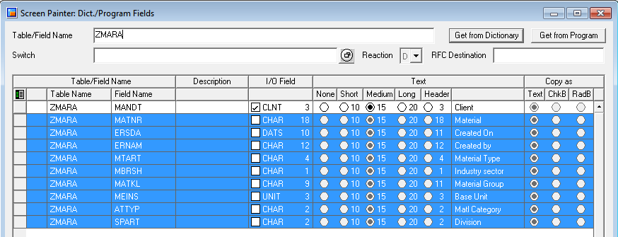
Module pool Programming
Screen Painter
Layout Editor: Fields Selection
Module Pool Programming
Overview
F6 - Field selection
Screen Painter
We can select fields from data dictionary or from Program. Select the fields and drop on Screen container
We can get fields from Data Dictionary or Program
Simple UI Elements
Input Validation
Navigation
Complex UI Elements
Notes:
First Slide

Slide 9
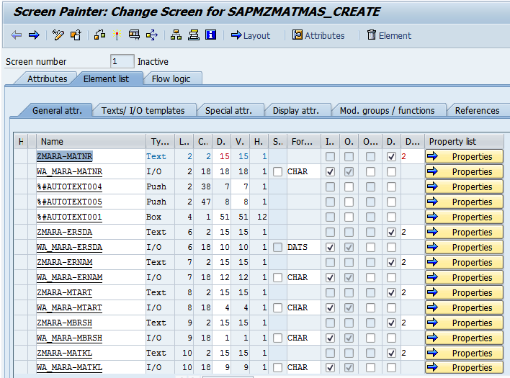
Module pool Programming
Screen Painter
UI Elements list and properties includes technical Properties and Display Properties
Module Pool Programming
Overview
Screen Painter
Simple UI Elements
Input Validation
Navigation
Complex UI Elements
Notes:
First Slide

Slide 10
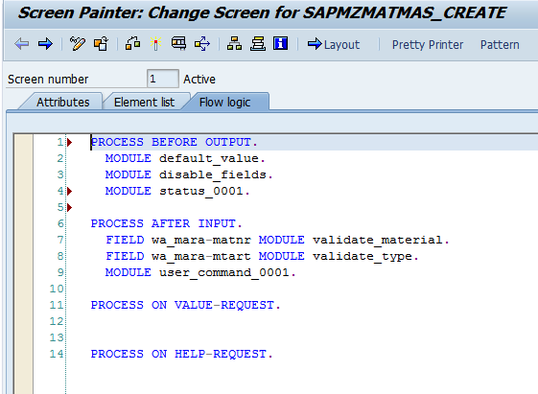
Module pool Programming
Screen Painter
Screen Painter: Flow Logic
Module Pool Programming
Overview
Output Modules implemented in ABAP/4 program and will be called from Screen Flow logic here
Screen Painter
Simple UI Elements
Input Modules implemented in ABAP/4 program and will be called from Screen Flow logic here
Input Validation
Navigation
Complex UI Elements
Output Modules: Called before screen display
Input Modules: Called after user action on Screen
Value Request Modules: Called when user press
F4 key on screen field
Help Request Modules: called when user press F1
Key on screen field
Notes:
First Slide

Slide 11
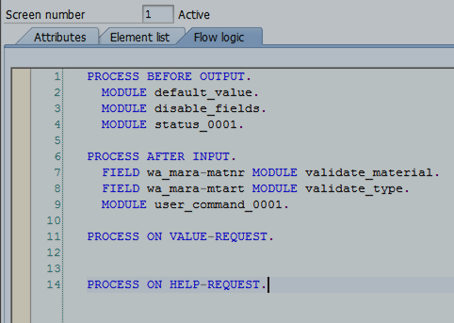
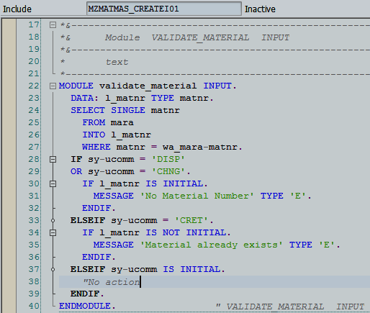
Module pool Programming
Screen Painter
Screen flow logic calls modules which are implemented in ABAP/4 Program
Module Pool Programming
Overview
Screen Painter
Simple UI Elements
Input Validation
Navigation
Complex UI Elements
Notes:
First Slide

Slide 12
Module pool Programming
Events
Events:
PBO: Process Before Output
it is triggered before the screen is displayed. It is generally used to initialize the screen Fields and also used to attached user interface and title
PAI: Process After Input
This event is triggered when the user enters data on to the screen field and click on push
Button or Menu item then the result will be displaying the data on to the next screen or updating The database
POH: Process On Help Request
This event is triggered when the user press F1 function key on screen field. This event is used to Avoid the standard help documentation provided by SAP through ABAP dictionary and provide The custom help documentation
POV: Process on Value Request
It is triggered when the user press F4 function key on screen field. It is used to avoid standard list of values provided by SAP through ABAP dictionary and will provide custom
List of values
Module Pool Programming
Overview
Screen Painter
Simple UI Elements
Input Validation
Navigation
Complex UI Elements
Notes:
First Slide

Slide 13
Module pool Programming
Events
Module Pool Programming
Overview
Screen Flow Logic
ABAP/4 Processing Logic
Screen Painter
PROCESS BEFORE OUTPUT.
MODULE stastus_0001
PROCESS AFTER INPUT.
MODULE user_command_0001.
MODULE status_0001 OUTPUT.
SET PF-STATUS ‘STATUS_1’.
SET TITLEBAR ‘TITLE_1’.
ENDMODULE.
MODULE user_command_0001 INPUT. CASE sy-ucomm. WHEN 'BACK'. WHEN 'CRET'. WHEN 'CHNG' OR 'DISP'. WHEN 'SAVE'. WHEN 'CLER'. ENDCASE. ENDMODULE. " USER_COMMAND_0001 INPUT
Simple UI Elements
Input Validation
Navigation
Complex UI Elements
Lets have small break for ABAP/4. will have a look at Application Server
Notes:
First Slide

Slide 14
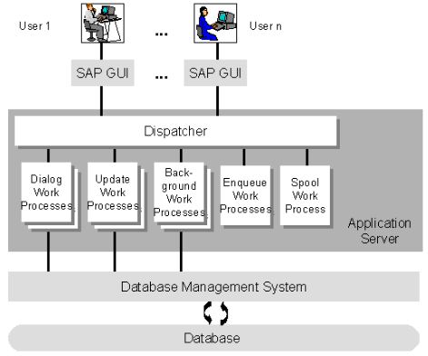
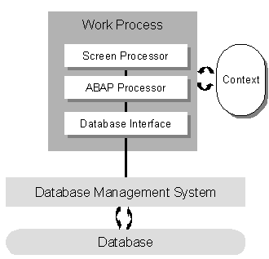
Module pool Programming
Before proceeding further
Module Pool Programming
Brief overview of Application Server
Every request from the GUI Will be handled by the dispatcher in the application server. Dispatcher will assign the request to any of the free Work process based on type of work. WP will continue to serve the GUI request
Work process having following parts
Overview
Screen Painter
Simple UI Elements
Input Validation
Navigation
Complex UI Elements
Notes:
First Slide

Slide 15
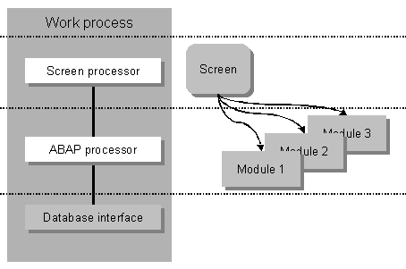
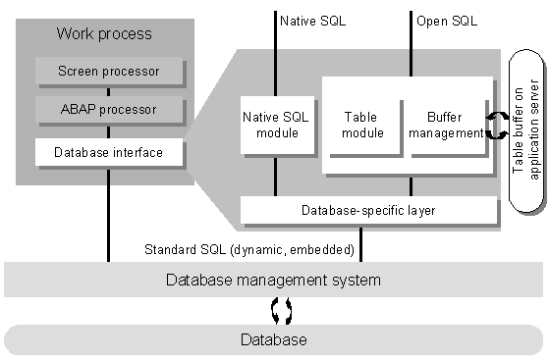
Module pool Programming
Before proceeding further
Module Pool Programming
Screen Processor will process screen flow logic.
It will call Modules in ABAP. Data will be automatically transferred from scree processor to ABAP processor and vice versa
ABAP/4 Processor will execute modules
Overview
Screen Painter
Simple UI Elements
Input Validation
Navigation
Complex UI Elements
Database Interface is responsible for Database interaction
Now Again will move to Module pool programming……………
Notes:
First Slide

Slide 16
Module pool Programming
Simple UI Elements
Simple UI elements
Text Field: It is for providing labels for input fields
Input Field: it is for accepting user input. We can make input field as drop down box as well
Checkbox: check box will accept user input as checked or unchecked
Radio Button: it is used to select only one option for group of options. We can assign function code to the radio button group for automatic triggering of PAI event. Function code will be captured in SY-UCOMM field
Push Button: Special input UI element. We will assign function code for buttons. Whenever
User clicked on this button, function code will be captured in system field SY-UCOMM. we can handle this function code in our program
Module Pool Programming
Overview
Screen Painter
Simple UI Elements
Input Validation
Navigation
Complex UI Elements
Notes:
First Slide

Slide 17
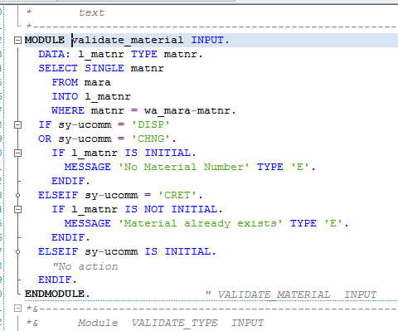
Module pool Programming
Input Validation
Input Validation:
we will use syntax FIELD <Field_Name> MODULE <Module_Name> to validate values in the Field <Field_Name> in the module <Module_Name>
Module Pool Programming
Overview
Screen Painter
Simple UI Elements
Input Validation
Navigation
Complex UI Elements
Validation for the screen field WA_MARA-MATNR is implemented in the module VALIDATE_MATERIAL
Notes:
First Slide

Slide 18
Module pool Programming
Input Validation
CHAIN & ENDCHAIN
It is used to validate group of screen fields
Whenever error message raised in the Module pool, except the input field for which we have entered value, all other fields will be disabled for input. System will not allow to enter the value
To avoid this situation we have to enclose list of fields which should be ready for user input in the CHAIN and ENDCHAIN as below
CHAIN.
Field WA_MARD-MATNR.
Field WA_MARD-WERKS
module VALIDATE_INPUT.
ENDCHAIN.
Module Pool Programming
Overview
Screen Painter
Simple UI Elements
Input Validation
Navigation
Complex UI Elements
Notes:
First Slide

Slide 19

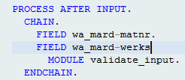
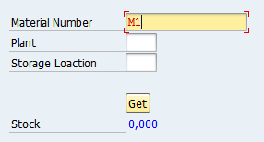
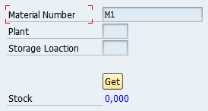
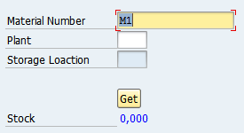
Module pool Programming
Input Validation
Fields not enclosed in
CHAIN & ENDCHAIN
Fields enclosed in
CHAIN & ENDCHAIN
Module Pool Programming
Overview
Screen Painter
Simple UI Elements
Input Validation
Navigation
Complex UI Elements
Notes:
First Slide

Slide 20
Module pool Programming
Navigation
Module Pool Programming
Based on complexity we will design one more screens. We can navigate from one screen to
another screen in two ways
Static Navigation
Dynamic Navigation
Static Navigation: In the screen attributes, we will specify the next screen number that has to be displayed once processing done in the current screen
Dynamic Navigation: with the help of following statements, we will navigate from one screen
To another screen.
SET SCREEN <Screen Number>
CALL SCREEN <Screen Number>
SET SCREEN <Screen Number> LEAVE SCREEN
LEAVE TO SCREEN <Screen Number>
Overview
Screen Painter
Simple UI Elements
Input Validation
Navigation
Complex UI Elements
Notes:
First Slide

Slide 21

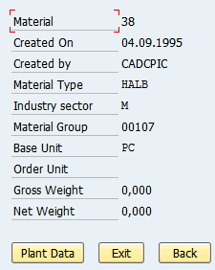
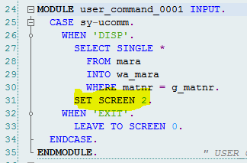
Module pool Programming
Navigation
SET SCREEN <Screen Number>:
This command dynamically calls the next screen by Executing the current screen. i.e. by executing the PAI module of the current screen.
To come back to the main screen, we have to provide the push button onto the next Screen with its respective code in it.
Module Pool Programming
Overview
Screen Painter
Simple UI Elements
First Screen. If we enter material number and hit Display button then it will navigate to the next screen for displaying material master
Input Validation
Navigation
Second Screen
PAI of First Screen
Complex UI Elements
Notes:
First Slide

Slide 22
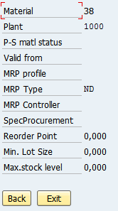
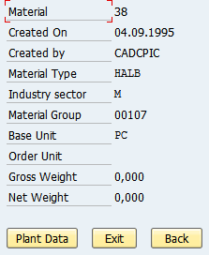
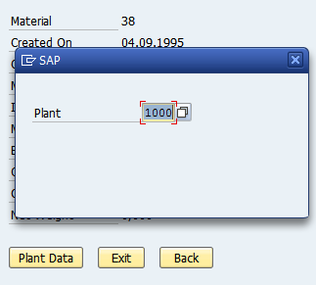
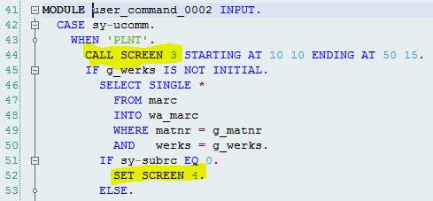
Module pool Programming
Navigation
CALL SCREEN <Screen Number>:
This statement calls a pop up screen called as model dialog box from the first screen without executing the current screen. i.e. its PAI module.
Module Pool Programming
Overview
Screen Painter
Simple UI Elements
Once you hit enter on third screen (Popup), it will navigate to second screen. Hence there is logic to navigate to fourth screen to display plant data fro material
Input Validation
Navigation
Complex UI Elements
If we click on Plant data button on second screen then one popup will be displayed(third screen). Once you enter Plant then hit enter
PAI Module of second screen
Notes:
First Slide

Slide 23
Module pool Programming
Navigation
CALL SCREEN <Screen Number>:
Note:
To make the pop up screen as model dialog box, we have to select the screen type as
Model Dialog box and next screen as ‘0’.
To comeback to the main screen, you no need to
Explicitly provide the push button on the pop up screen with its respective code. But just
Hit enter will bring you back to the main screen
Module Pool Programming
Overview
Screen Painter
Simple UI Elements
Input Validation
Navigation
Complex UI Elements
Notes:
First Slide

Slide 24
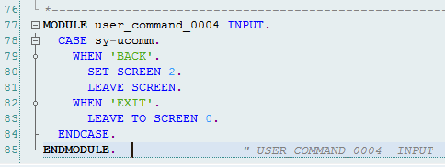
Module pool Programming
Navigation
Module Pool Programming
LEAVE TO SCREEN <Screen Number> OR
SET SCREEN <Screen Number> LEAVE SCREEN
This command call the next screen dynamically without executing the current screen that is its PAI Module
To comeback to the main screen from the next screen you need to explicitly provide the push button with its respective code in the next screen
Overview
Screen Painter
Simple UI Elements
Input Validation
Back and Exit Buttons
To go back to previous screen, we will use
LEAVE TO SCREEN <Prev_Screen> OR
SET SCREEN <prev_screen> LEAVE SCREEN
Above commands will close screen sequence
If we want to exit completely then use
LEAVE TO SCREEN 0
Navigation
Complex UI Elements
Notes:
First Slide

Slide 25
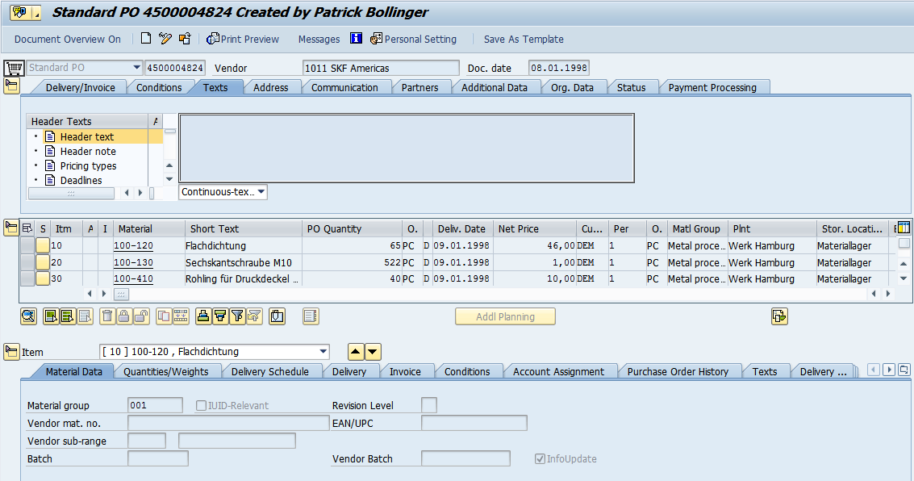
Module pool Programming
Complex UI Elements
Module Pool Programming
Complex UI Elements
Sub screen
Table
Tab Strips
Overview
Screen Painter
Simple UI Elements
Input Validation
Navigation
Tab Strips
Complex UI Elements
Table
Notes:
First Slide

Slide 26
Module pool Programming
Complex UI Elements: Sub Screen
Module Pool Programming
Sub screen is a screen with in a screen
Steps:
Create a main screen as a normal screen and provide the sub screen area onto it and name it
Create another screen as type sub screen
Arrange the fields on the sub screen such that they should fit the sub screen area
Call the sub screen in the screen flow logic
Overview
Screen Painter
Simple UI Elements
Input Validation
Navigation
Complex UI Elements
Notes:
First Slide

Slide 27
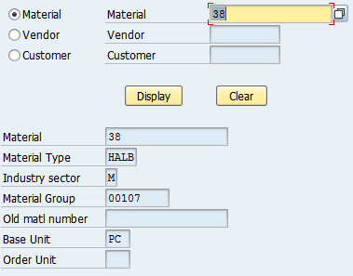
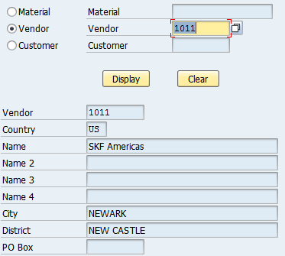
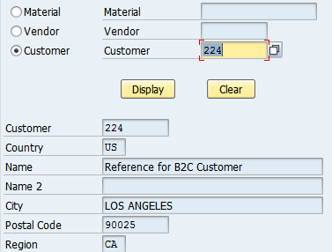
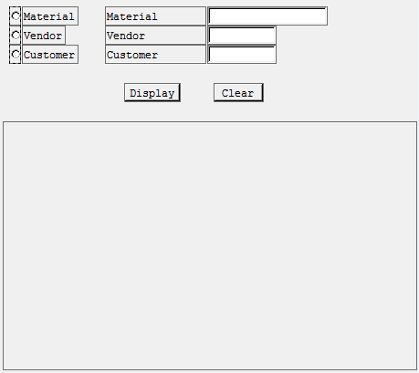
Module pool Programming
Complex UI Elements: Sub Screen
Module Pool Programming
Overview
Screen Painter
Simple UI Elements
Input Validation
Navigation
This is Main screen. It contains Radio Buttons, Push Buttons and Sub screen Area
Complex UI Elements
This is sub screen Area
Dynamically screen will be placed in this area
Notes:
First Slide

Slide 28
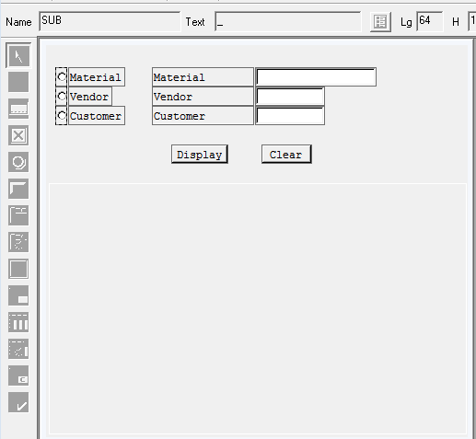
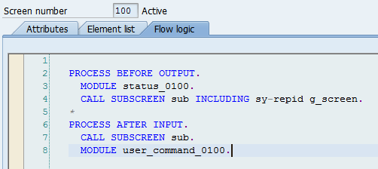
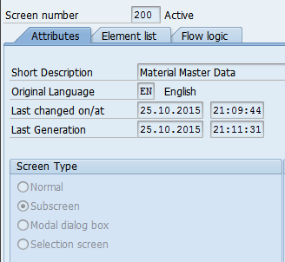
Module pool Programming
Complex UI Elements: Sub Screen
Module Pool Programming
Overview
Screen Painter
Simple UI Elements
Input Validation
Navigation
Complex UI Elements
Drag & Drop Sub screen area on to the Screen
Provide name to the Sub screen area
Add logic in Flow logic to dynamically place the other screen in the sub screen area
PBO:
CALL SUBSCREEN <name> INLCLUDING <prog_name> <screen_Number>
PAI:
CALL SUBSCREEN <name>
Screen <Screen_Number> should be sub scree type
Screen type should be Sub Screen
Notes:
First Slide

Slide 29

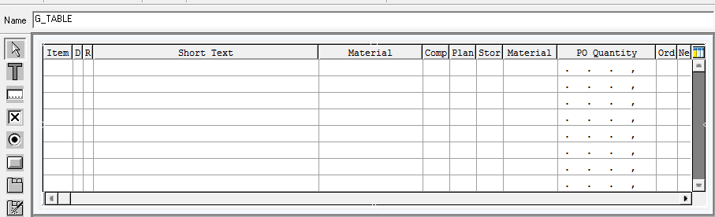
Module pool Programming
Complex UI Elements: Table Control
Table control is a screen table which displays multiple records on to it. Table control act as a loop when code is written to it.
Module Pool Programming
Overview
Table Control in left navigation pane in screen editor
Screen Painter
Simple UI Elements
Drag and drop the table control on to the Screen container, Name it and add the fields on
to the table control
Input Validation
Navigation
Complex UI Elements
Notes:
First Slide

Slide 30
Module pool Programming
Complex UI Elements: Table Control
Declare table control variable in the main program as follows
Syntax:
CONTROLS <table name> TYPE TABLEVIEW USING SCREEN <Screen Number>
Module Pool Programming
Overview
Screen Painter
Logic to populate records in table control in PBO Events
LOOP AT <Internal Table> INTO <work area> WITH CONTROL <control Name>
ENDLOOP
Logic to get modified records from table control in PAI Events
LOOP AT <Internal Table>.
ENDLOOP
Simple UI Elements
Input Validation
Navigation
Complex UI Elements
Notes:
First Slide

Slide 31
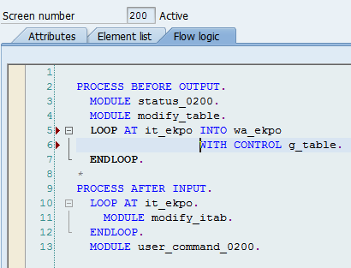
Module pool Programming
Complex UI Elements: Table Control
Module Pool Programming
Example:
Declare Table Control variable
Overview
Screen Painter
Logic to populate data on to the table control and retrieve modified data from
Table control
Simple UI Elements
Input Validation
Navigation
This loop will populate data on to the screen control
Complex UI Elements
This loop will retrieve data from screen control to internal table
Data will not be automatically updated in Internal table. Logic has to be written explicitly
Notes:
First Slide

Slide 32
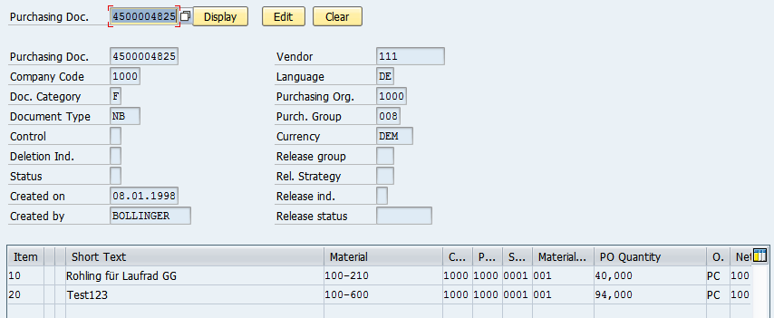
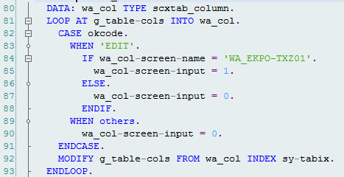

Module pool Programming
Complex UI Elements: Table Control
Module Pool Programming
Overview
Screen Painter
Simple UI Elements
Input Validation
Navigation
Complex UI Elements
Making columns enable or disable in the table control:
we can loop table control in the PBO Event and change properties of each and every column
Notes:
First Slide

Slide 33
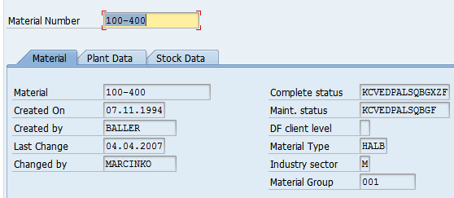
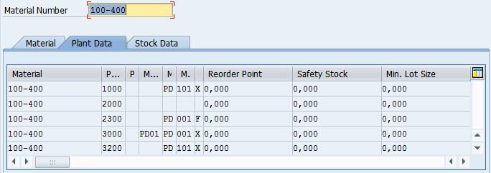
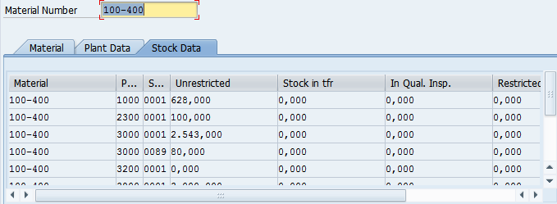
Module pool Programming
Complex UI Elements: Tabstrip
Tabstrip control displays several screens and on selecting each tab associated screen will be displayed
Module Pool Programming
Overview
Screen Painter
We have three tabs in the screen. by default any one of the tab will be selected.
Simple UI Elements
Input Validation
Navigation
Complex UI Elements
Sub screen has to be included each tab to display another screen
Each tab having its own name and function code attached to it
Notes:
First Slide

Slide 34

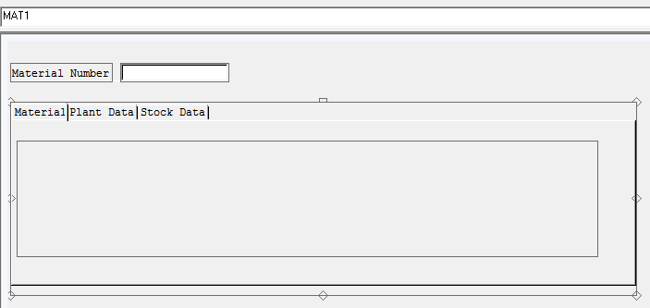
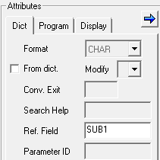


Module pool Programming
Complex UI Elements: Tabstrip
Module Pool Programming
Tab strip control in the left navigation pane
Overview
Screen Painter
Simple UI Elements
Input Validation
Tabs
Navigation
Sub screen area
Complex UI Elements
Each Tab having 3 mandatory properties
Name
Function Code
Ref Field: Sub screen name
Notes:
First Slide

Slide 35
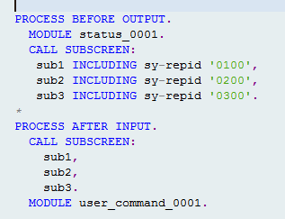
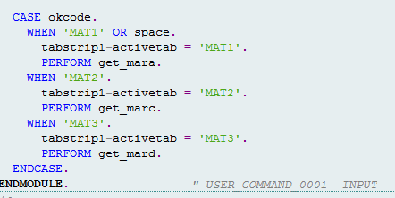
Module pool Programming
Complex UI Elements: Tabstrip
Module Pool Programming
Overview
Flow Logic:
If we add the separate sub screen in each tab then we have to call all the sub screens in the PBO and PAI
Screen Painter
Simple UI Elements
Input Validation
Navigation
Complex UI Elements
PAI Logic:
Whenever we select the tab then We have to activate the tab by setting the tab name to it as below
<tab strip name>-ACTIVETAB = <tab name>
Notes:
First Slide

Slide 36
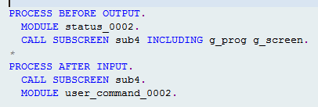
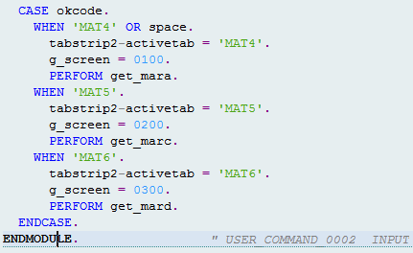
Module pool Programming
Complex UI Elements: Tabstrip
Module Pool Programming
Overview
Flow Logic:
If we add the single sub screen for all the tabs then we have to call only one sub screens in the PBO and PAI
Screen Painter
Simple UI Elements
Input Validation
Navigation
PAI Logic:
Whenever we select the tab then We have to activate the tab and need to call associate screen by setting the tab name to it as below
<tab strip name>-ACTIVETAB = <tab name>
G_screen = <Screen Number>
Complex UI Elements
Notes:
First Slide

